Slide 1
Overview:
Introduction/Motivation
Dynamics
Control Law
Disturbance Observer
Results
Discussion/Continued work
Control Objectives:
Perform attitude control on a flapping-wing vehicle
Ensure finite-time convergence to stable hover condition
Reject external disturbances by designing an observer with finite time convergence
Motivation:
Control law may be deployed in an inner loop for tracking

Slide 2
Overview:
Introduction:
What are MAV’s? What are the applications
What will this paper demonstrate. Define the control objectives
Dynamics:
What are the “general” dynamics? What’s the typical formulation?
How we reduce the dynamics about hovering. FIG 1A/B – BODY AND INPUTS
Final dynamics well work with
Control law:
Sliding mode control: define s, V(s) and show vdot is neg, def
Define the observer and show convergence
Results / Discussion:
Table of parameters. Connection between dynamics and values well use
Convergence of a non-zero initial condition FIG 2
Disturbance recreation – FIG 3
Reaction to disturbance – FIG 4
Sliding surface FIG 5
Inputs – FIG 6
Conclusion: Did we meet our objectives? What are the limitations? Future work.

Slide 3
Final figures:
Fig 2
Fig 4 w/ zoomed in option

Slide 4
Fig 5
Fig 3

Slide 5



$$t>5$$
$$t=0$$
$$t>10$$

Slide 6
Fig 6

Slide 7
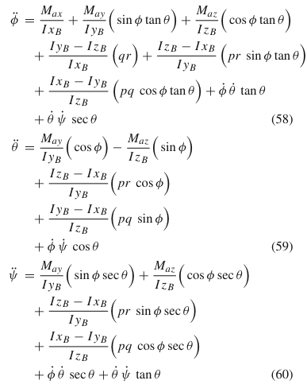
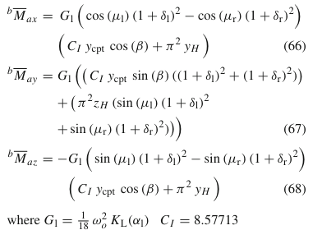
Dynamics/Governing Eqns
Partial linearization about hovering condition leads to more amenable dynamics to apply a nonlinear control technique.
Partially linearize about hovering by performing system ID
[Tran, 2018]
[Cheng, 2010]
[Taylor, 2003]
[Wissa, 2020]

Slide 8
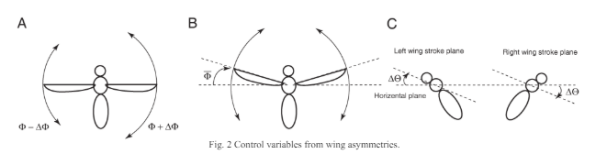





Dynamics/Governing Eqns
Partial linearization about hovering condition leads to more amenable dynamics to apply a nonlinear control technique.
$x=[ψ_{R}, ψ_{P}, ψ_{Y}, \dot{ψ_{R}}, \dot{ψ_{P}}$ $, \dot{ψ_{Y}}]$
$$\dot{ω}=Aω+Bu+d(t)$$
$$u={\left[ΔΦ, \overline{Φ}, Δβ\right]}^{T}$$
[Tran, 2018]
[Tran, 2018]
Inputs are changes to a stroke plane angle, wing sweep, and wing angle that are calculated about a hovering state

Slide 9
Control Law
Define the following sliding surface/control law:
$$s=ω+Γψ$$
$$u=−B^{−1}[\left(A+T\left(ψ\right)\right)ω+d\left(t\right)+κ_{1}s+κ_{2}\operatorname{sgn}\left(s\right)]$$
$$V=\frac{1}{2}s^{T}s$$
$$\dot{V}=\dot{s}s$$
Go to [Tran, 2018] and scratch paper for proof of exponential convergence
Observer Design
Go to [Tran, 2018] and scratch paper for proof of observer convergence

Slide 10
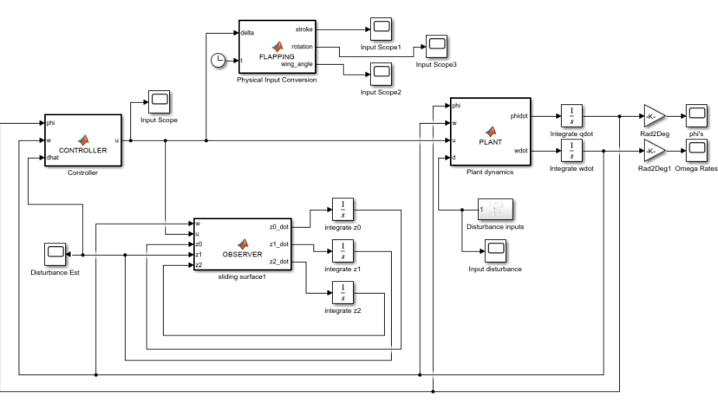
Implementation
Plant: refer slide 3. Controller: refer slide 4. Observer: refer slide 4/paper notes

Slide 11
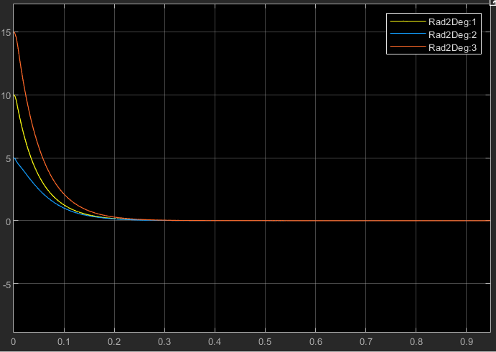
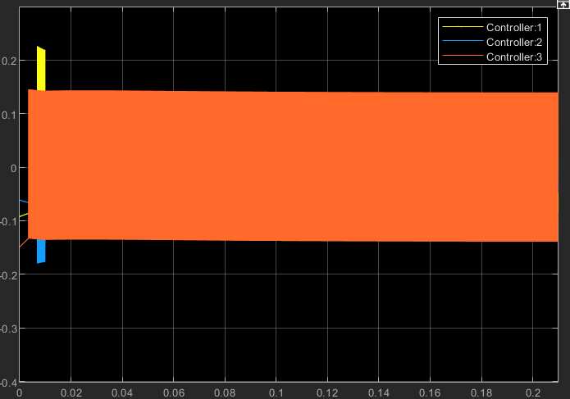
Results – initial condition to convergence with no disturbance
Euler angles, in deg, from [10, 5, 15] initial condition
Control effort, in radians

Slide 12
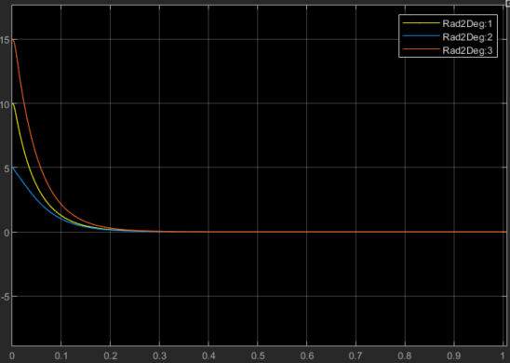
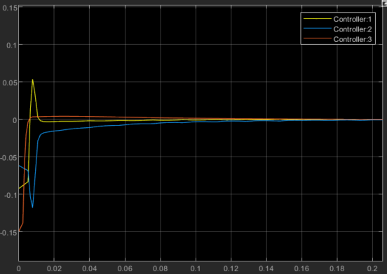
Results – initial condition to convergence with no disturbance
Euler angles, in deg, from [10, 5, 15] initial condition
Control effort after sat(s) (tuned to eps = 0.5) implemented, in radians

Slide 13
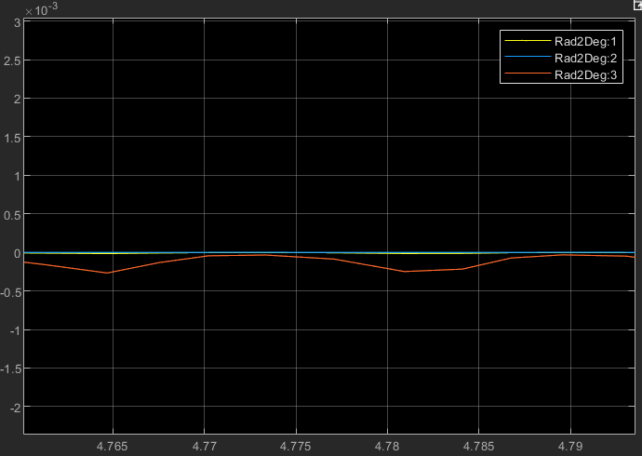
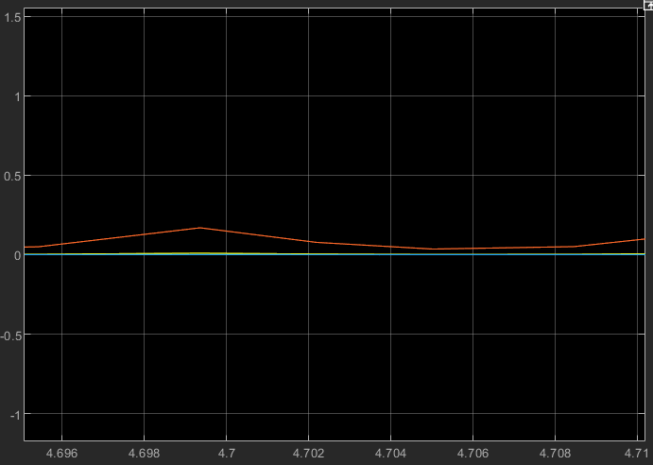
Results – initial condition to convergence with no disturbance
Small persistent offset caused sat(s) only guaranteeing a region of attraction – phi’s in deg
Small persistent offset caused sat(s) only guaranteeing a region of attraction – omega in deg/s

Slide 14
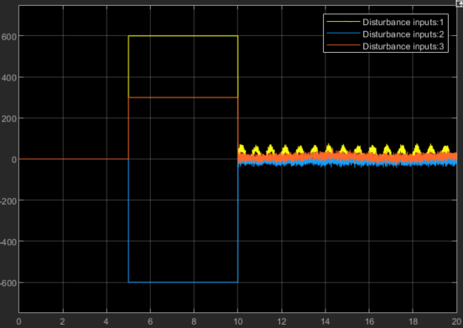
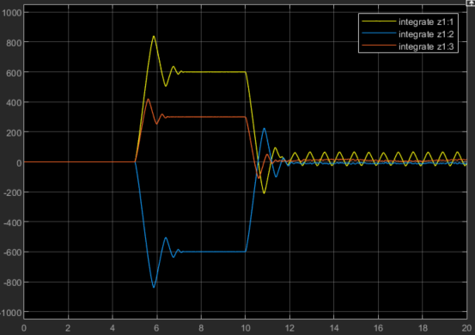
Results – Disturbance
Injected Disturbance [mN]
Disturbance estimation [mN]

Slide 15
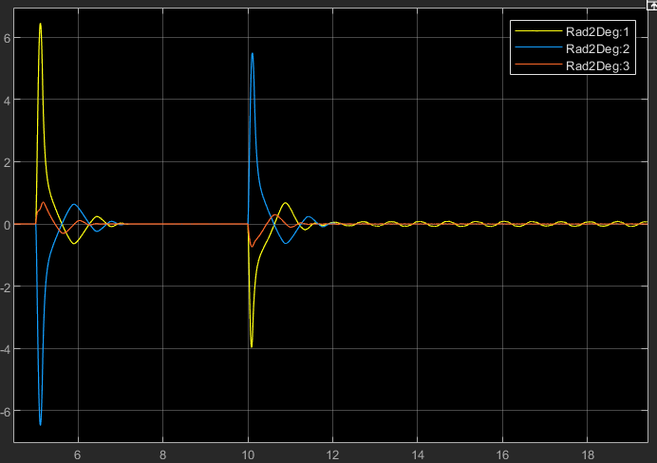
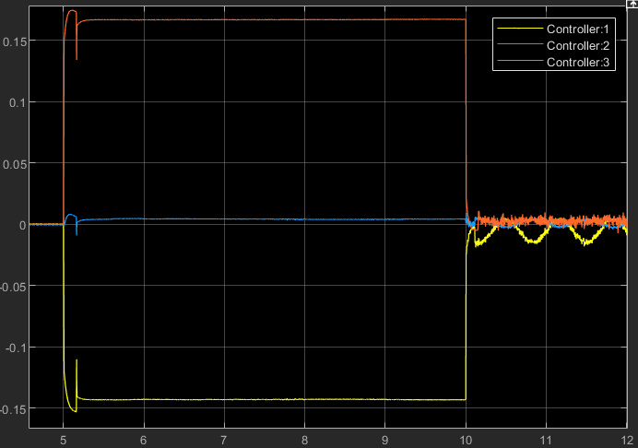
Results – Response to disturbance
Euler angles (deg)
Control effort (rad)

Slide 16
Discussion:
Objectives achieved:
Perform attitude control on a flapping-wing vehicle ✓
Ensure finite-time convergence to stable hover condition ✓
Reject external disturbances by designing an observer with finite time convergence ✓
Remaining Work:
Clean up plots, etc.
Organize citations/prior work
Finalize Lyapunov proof
Anything else?

